Slide 1
Welcome to the Class
PASS - Welcome to the class, Jayita!
Lab Assignment

Slide 2
Instructions
Make a copy of this document and fill it with your responses.
For each question, use the space on the slide to show your response, and/or add additional slides as needed. Highlight your responses where possible so that we can see them easily
Place the completed document into your Lab Assignments folder and include a link to it in when you submit.
Submit using the lab assignment submission form which can be found on the class website.

Slide 3
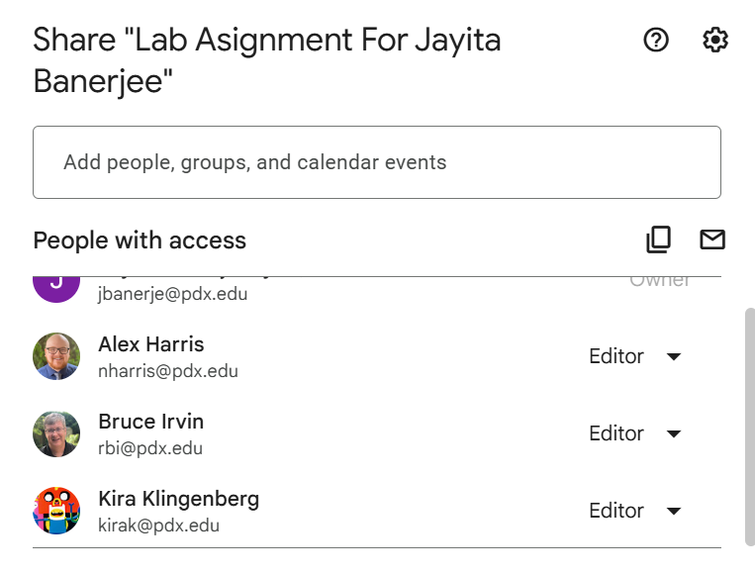
1. Create a GDrive folder called “Lab Assignments for <student name>” and share it with the Instructors and TA (editor permissions). Include a screenshot here showing that the folder is correctly named and shared.

Slide 4
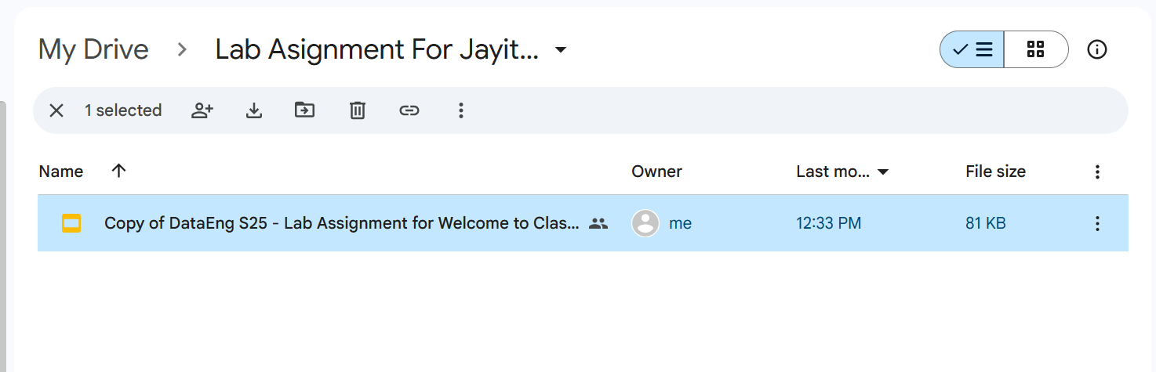
2. Move this lab assignment document into your Lab Assignments folder

Slide 5
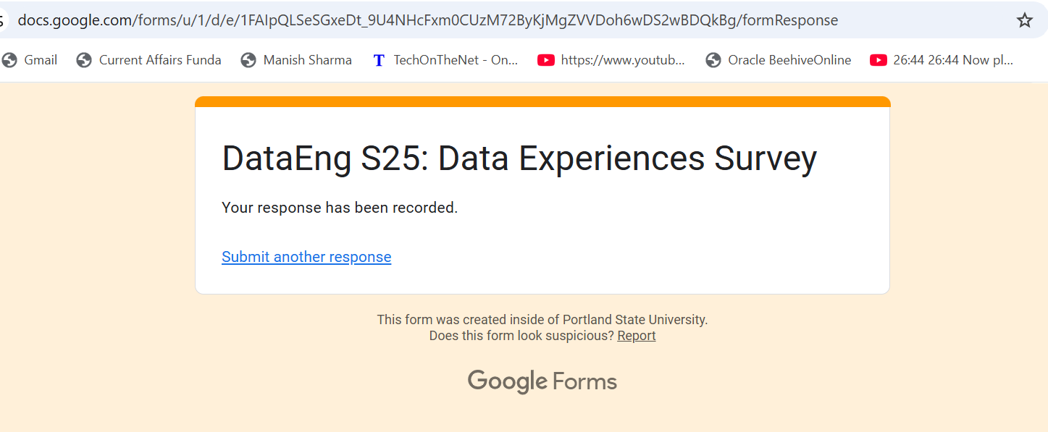
3. Fill and Submit this survey: link

Slide 6
4. Which part(s) of the Data Engineering class seem(s) most interesting to you?
For me all parts are interesting as I have not that much idea about Data Engineering.But I am super excited about Data Integration part.

Slide 7
5. Your python development environment
A. In what environment or tool do you plan to develop python code for this class?
I am planning to do at Google Colab.
B. Is it installed, configured and otherwise ready for you to use?
This is Online platform.
C. Have you used this tool/environment before?
Yes.
D. What is your proficiency level with python (beginner, inexperience, intermediate, proficient, or expert)?
Beginner with Python
E. Have you used pandas before?
No

Slide 8
5. Your GCP experience
A. Have you used Google Cloud Platform (GCP) before?
B. What is your proficiency level with GCP (beginner, inexperience, intermediate, proficient, or expert)?
(GCP expertise is nice but not required to start this class)
I have not used Google Cloud Platform before.

